Slide 1
ENGINEERING GRAND CHALLENGE!
PREVENT NUCLEAR TERRORISM

Slide 2
“DIRTY BOMBS”
Conventional explosive devices mixed with low-grade radioactive material.
Can be small and easily concealed.
Have the potential to cause long-term negative effects, including increased cancer risk and economic damage.

Slide 3
WHY SHOULD I WORRY?
Prior Events
BBC Documentary “Dirty Bomb”
1995 Moscow, Russia- Dirty bomb discovered in a public park, did not explode, first major instance of a dirty bomb threat.

Slide 4
HERE’S THE PROBLEM
1987 Goiânia [Goy-ya-nya], Brazil
A container of powdered radioactive cesium is cut open in a scrapyard and spreads.
100,000 queued for radiation testing, swamping clinics and hospitals.
249 people were contaminated and 4 died.
Contaminated topsoil had to be removed and several homes and businesses had to be destroyed.
The cleanup took 6 months and enough material was taken away to cover a football field up to waist height.
This incident was purely accidental, not a terrorist attack

Slide 5
HERE’S THE PROBLEM
International Atomic Energy Agency
In 2013, there were 146 confirmed incidents of thefts and other unauthorized activities relating to nuclear substances.

Slide 6
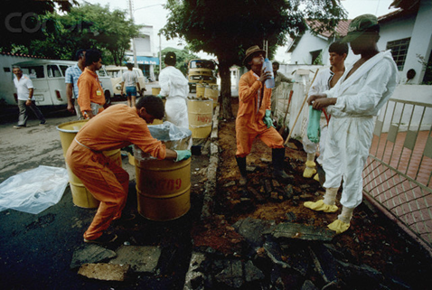
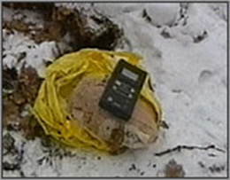
© Karen Kasmauski/Corbis
© WGBH/NOVA

Slide 7
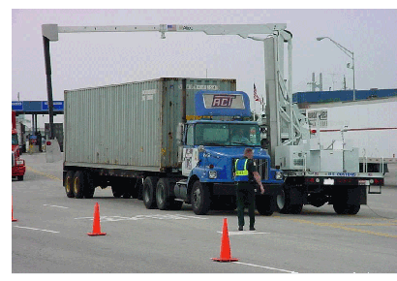
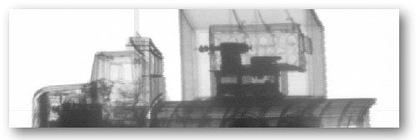
WHAT IS CURRENTLY BEING DONE?
Scanning for radioactive materials at ports
Container Security Initiative
5% of containers scanned
$100 per container (2011, Management Science)
SAFE Ports Act of 2006
9/11 Commision Act of 2007
Florida Department of Transportation
Wikimedia Commons

Slide 8
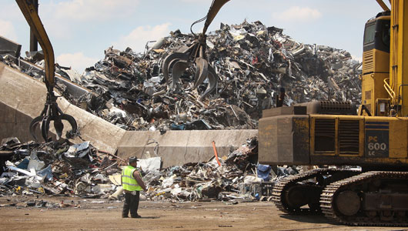
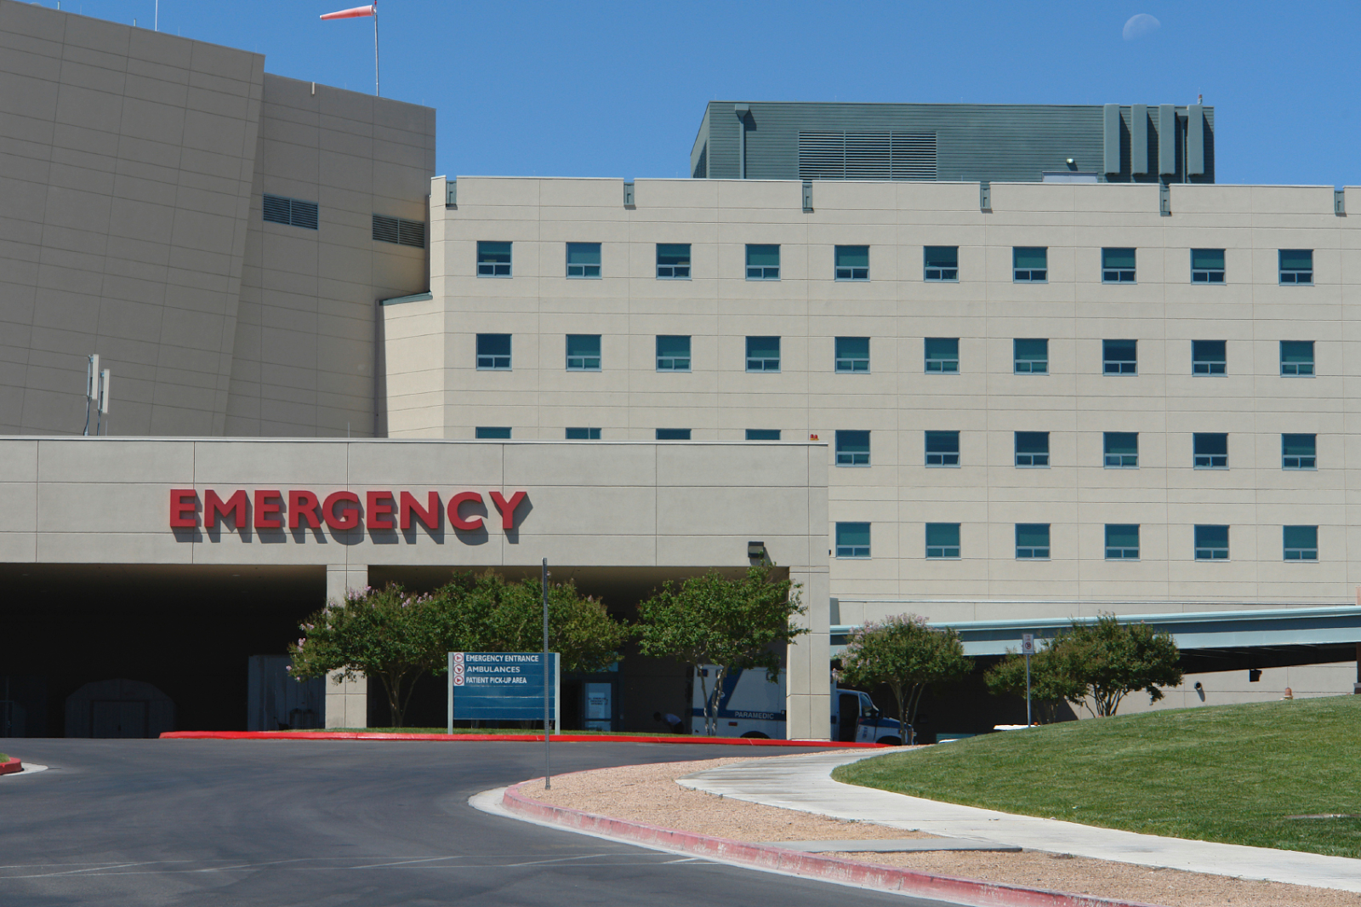
© Mother Nature Network
© University of Arkansas

Slide 9
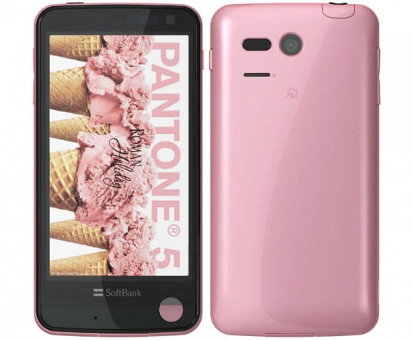
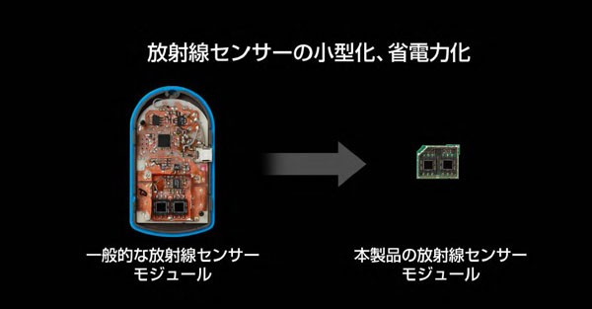
EXISTING TOOLS
© Sharp/SoftBank
© Sharp/SoftBank
A typical radiation sensor module
The radiation sensor module in the Pantone 5

Slide 10
OUR PROPOSAL
Idea: Putting radiation detectors in smartphones.
Data will be sent automatically to a large central database.
Automatic detection of characteristic patterns.
The proper authorities are dispatched.

Slide 11
CHALLENGES WE UNCOVERED
Cost $$
Size of detector/fitting in phone
Software/Security for database
Energy/Battery life
Getting people to use it
Convincing the Government to manage database

Slide 12
ETHICAL CHALLENGES/DILEMMAS
Breach of Privacy
GPS Tracking
Consent of General Public
Hacking/ Exploiting the System (ISIS)

Slide 13
OTHER NECESSARY DISCIPLINES
Law
Math/Physics
Business (Apple/Samsung/Verizon)
Politics/Foreign Policy

Slide 14
DEGREE APPLICATIONS
Mechanical Engineering: Making everything fit in smartphone/making it work.
Computer Science: Creating database/programming phone software.
Electrical Engineering: Converting radiation data into usable electrical signal.
Chemical Engineering: Developing radiation detector materials.
Bioengineering: Making sensor materials safe and consumer friendly.

Slide 15
Questions?

